Slide 1
CS276: Information Retrieval and Web Search
Christopher Manning and Pandu Nayak
Lecture 14: Learning to Rank (with GBDTs)
Borrows slides/pictures from Schigehiko Schamoni

Slide 2
Machine learning for IR ranking?
Sec. 15.4
We’ve looked at methods for ranking documents in IR
Cosine similarity, inverse document frequency, BM25, proximity, pivoted document length normalization, (will look at) Pagerank, …
We’ve looked at methods for classifying documents using supervised machine learning classifiers
Rocchio, kNN, decision trees, etc.
Surely we can also use machine learning to rank the documents displayed in search results?
Sounds like a good idea
Known as “machine-learned relevance” or “learning to rank”

Slide 3


Slide 4
Machine learning for IR ranking
This “good idea” has been actively researched – and actively deployed by major web search engines – in the last 10 years
Why didn’t it happen earlier?
Modern supervised ML has been around for about 25 years…
Naïve Bayes has been around for about 60 years…

Slide 5
Machine learning for IR ranking
There’s some truth to the fact that the IR community wasn’t very connected to the ML community
But there were a whole bunch of precursors:
Wong, S.K. et al. 1988. Linear structure in information retrieval. SIGIR 1988.
Fuhr, N. 1992. Probabilistic methods in information retrieval. Computer Journal.
Gey, F. C. 1994. Inferring probability of relevance using the method of logistic regression. SIGIR 1994.
Herbrich, R. et al. 2000. Large Margin Rank Boundaries for Ordinal Regression. Advances in Large Margin Classifiers.

Slide 6
Why weren’t early attempts very successful/influential?
Sometimes an idea just takes time to be appreciated…
Limited training data
Especially for real world use (as opposed to writing academic papers), it was very hard to gather test collection queries and relevance judgments that are representative of real user needs and judgments on documents returned
This has changed, both in academia and industry
Poor machine learning techniques
Insufficient customization to IR problem
Not enough features for ML to show value

Slide 7
Why wasn’t ML much needed?
Traditional ranking functions in IR used a very small number of features, e.g.,
Term frequency
Inverse document frequency
Document length
It was easy possible to tune weighting coefficients by hand
And people did
You students do it in PA3
Notes:
Some of you even grid searched a bit. Some of you suffered spending a lot of time tuning

Slide 8
Why is ML needed now?
Modern (web) systems use a great number of features:
Arbitrary useful features – not a single unified model
Log frequency of query word in anchor text?
Query word in color on page?
# of images on page?
# of (out) links on page?
PageRank of page?
URL length?
URL contains “~”?
Page edit recency?
Page loading speed
The New York Times in 2008-06-03 quoted Amit Singhal as saying Google was using over 200 such features (“signals”) – so it’s sure to be over 500 today. ☺

Slide 9
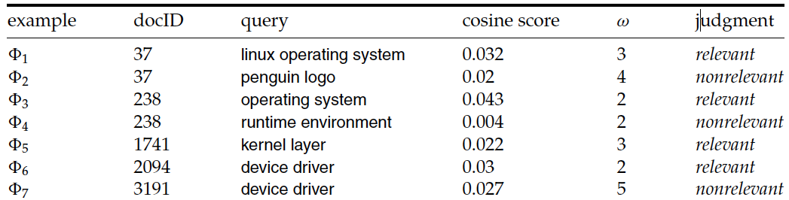
Simple example: Using classification for ad hoc IR
Sec. 15.4.1
Collect a training corpus of (q, d, r) triples
Relevance r is here binary (but may be multiclass, with 3–7 values)
Query-Document pair is represented by a feature vector
x = (α, ω) α is cosine similarity, ω is minimum query window size
ω is the the shortest text span that includes all query words
Query term proximity is an important new weighting factor
Train a machine learning model to predict the class r of a document-query pair
Notes:
But query term proximity isn’t so good on our PA3 dataset….

Slide 10
Simple example: Using classification for ad hoc IR
Sec. 15.4.1
A linear score function is then
Score(d, q) = Score(α, ω) = aα + bω + c
And the linear classifier is
Decide relevant if Score(d, q) > θ
… just like when we were doing text classification

Slide 11
Simple example: Using classification for ad hoc IR
Sec. 15.4.1
0.05
Decision surface
R
cosine score α
R
N
R
R
R
R
R
N
N
0.025
R
R
R
R
N
N
N
N
N
N
N
0
2
3
4
5
Term proximity ω

Slide 12
More complex example of using classification for search ranking [Nallapati 2004]
We can generalize this to classifier functions over more features
We can use other methods for learning the linear classifier weights

Slide 13
An SVM classifier for information retrieval [Nallapati 2004]
Let relevance score g(r|d,q) = w•f(d,q) + b
Uses SVM: want g(r|d,q) ≤ −1 for nonrelevant documents and g(r|d,q) ≥ 1 for relevant documents
SVM testing: decide relevant iff g(r|d,q) ≥ 0
Features are not word presence features (how would you deal with query words not in your training data?) but scores like the summed (log) tf of all query terms
Unbalanced data (which can result in trivial always-say-nonrelevant classifiers) is dealt with by undersampling nonrelevant documents during training (just take some at random)
Notes:
The r here is the notion of being relevant, like P(R|D,Q) in BIM model of probabilistic IR. It’s really irrelevant and could be a constant r=1.

Slide 14
An SVM classifier for information retrieval [Nallapati 2004]
Experiments:
4 TREC data sets
Comparisons with Lemur, a state-of-the-art open source IR engine (Language Model (LM)-based – see IIR ch. 12)
Linear kernel normally best or almost as good as quadratic kernel, and so used in reported results
6 features, all variants of tf, idf, and tf.idf scores

Slide 15
An SVM classifier for information retrieval [Nallapati 2004]
Train \ Test |  | Disk 3 | Disk 4-5 | WT10G (web)
TREC Disk 3 | Lemur | 0.1785 | 0.2503 | 0.2666
 | SVM | 0.1728 | 0.2432 | 0.2750
Disk 4-5 | Lemur | 0.1773 | 0.2516 | 0.2656
 | SVM | 0.1646 | 0.2355 | 0.2675
At best the results are about equal to Lemur
Actually a little bit below
Paper’s advertisement: Easy to add more features
This is illustrated on a homepage finding task on WT10G:
Baseline Lemur 52% success@10, baseline SVM 58%
SVM with URL-depth, and in-link features: 78% success@10

Slide 16
“Learning to rank”
Sec. 15.4.2
Classification probably isn’t the right way to think about approaching ad hoc IR:
Classification problems: Map to an unordered set of classes
Regression problems: Map to a real value [See PA3]
Ordinal regression (or “ranking”) problems: Map to an ordered set of classes
A fairly obscure sub-branch of statistics, but what we want here
This formulation gives extra power:
Relations between relevance levels are modeled
Documents are good versus other documents for a query given collection; not an absolute scale of goodness

Slide 17
“Learning to rank”
Assume a number of categories C of relevance exist
These are totally ordered: c₁ < c₂ < … < c_{J}
This is the ordinal regression setup
Assume training data is available consisting of document-query pairs (d, q) represented as feature vectors x_{i} with relevance ranking c_{i}

Slide 18
Algorithms used for ranking in search
Support Vector Machines (Vapnik, 1995)
Adapted to ranking: Ranking SVM (Joachims 2002)
Neural Nets: RankNet (Burges et al., 2006)
Tree Ensembles
Random Forests (Breiman and Schapire, 2001)
Boosted Decision Trees
Multiple Additive Regression Trees (Friedman, 1999)
Gradient-boosted decision trees: LambdaMART (Burges, 2010)
Used by all search engines? AltaVista, Yahoo!, Bing, Yandex, …
All top teams in the 2010 Yahoo! Learning to Rank Challenge used combinations with Tree Ensembles!
Notes:
So let’s focus on gradient boosted decision trees and work up to them!

Slide 19
Yahoo! Learning to Rank Challenge
(Chapelle and Chang, 2011)
Yahoo! Webscope dataset : 36,251 queries, 883k documents, 700 features, 5 ranking levels
Ratings: Perfect (navigational), Excellent, Good, Fair, Bad
Real web data from U.S. and “an Asian country”
set-1: 473,134 feature vectors; 519 features; 19,944 queries
set-2: 34,815 feature vectors; 596 features; 1,266 queries
Winner (Burges et al.) was linear combo of 12 models:
8 Tree Ensembles (LambdaMART)
2 LambdaRank Neural Nets
2 Logistic regression models

Slide 20
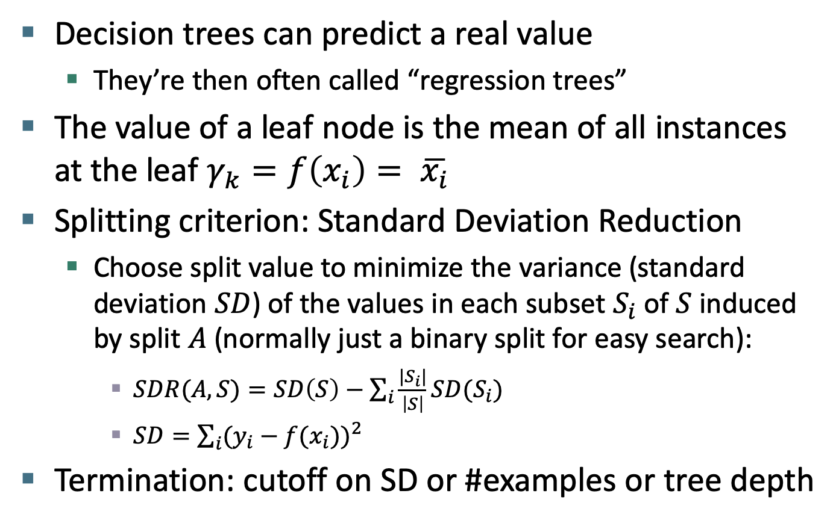
Regression trees
Decision trees can predict a real value
They’re then often called “regression trees”
The value of a leaf node is the mean of all instances at the leaf $γ_{k}=f\left(x_{i}\right)= \overline{x_{i}}$
Splitting criterion: Standard Deviation Reduction
Choose split value to minimize the variance (standard deviation $SD$) of the values in each subset $S_{i}$ of $S$ induced by split $A$ (normally just a binary split for easy search):
$SDR(A,S)=SD\left(S\right)−\sum_{i}{\frac{{|S}_{i}|}{\left|S\right|}SD(S_{i})}$
$SD=\sum_{i}{{(y_{i}−f(x_{i}))}^{2}}$
Termination: cutoff on SD or #examples or tree depth

Slide 21
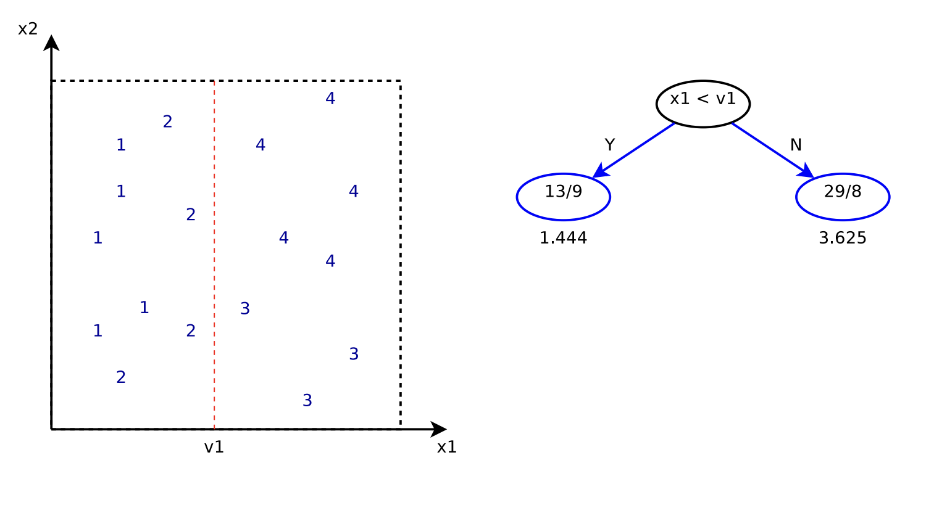
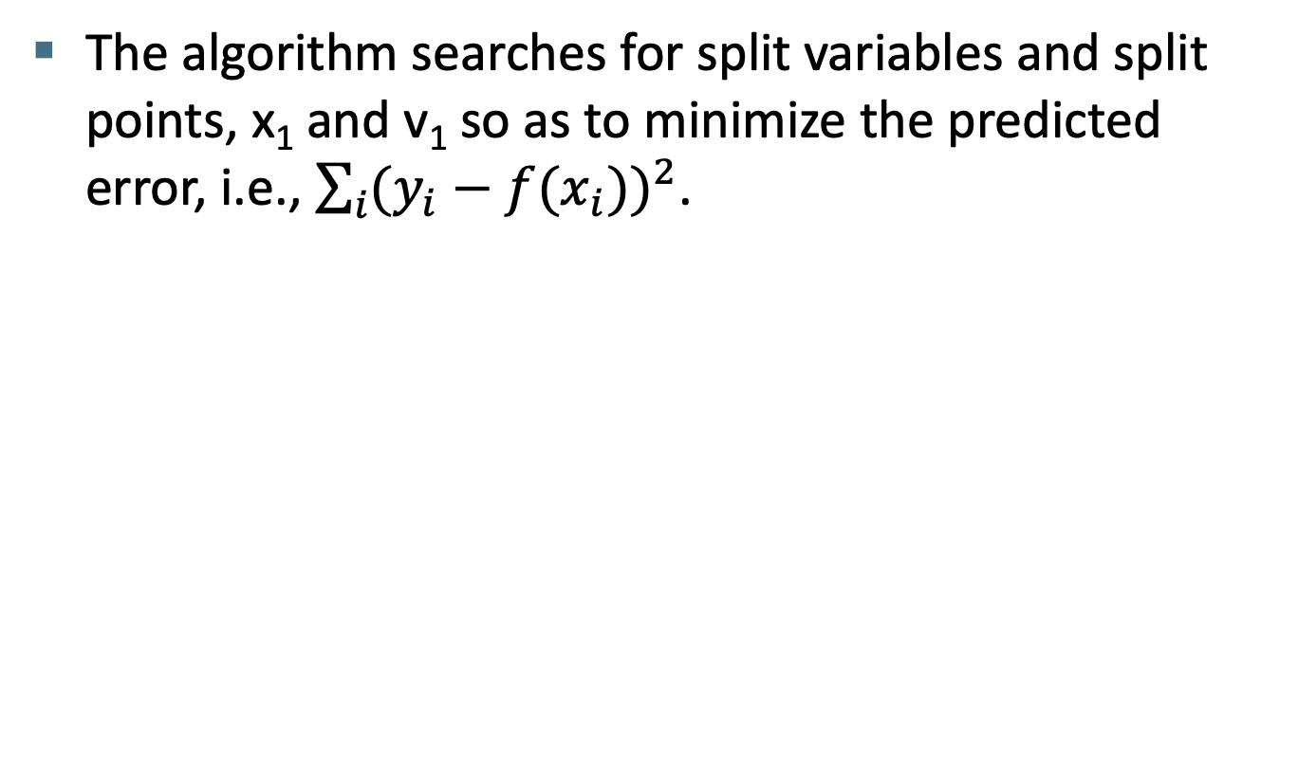
Training a regression tree
The algorithm searches for split variables and split points, x₁ and v₁ so as to minimize the predicted error, i.e., $\sum_{i}{{(y_{i}−f(x_{i}))}^{2}}$.

Slide 22
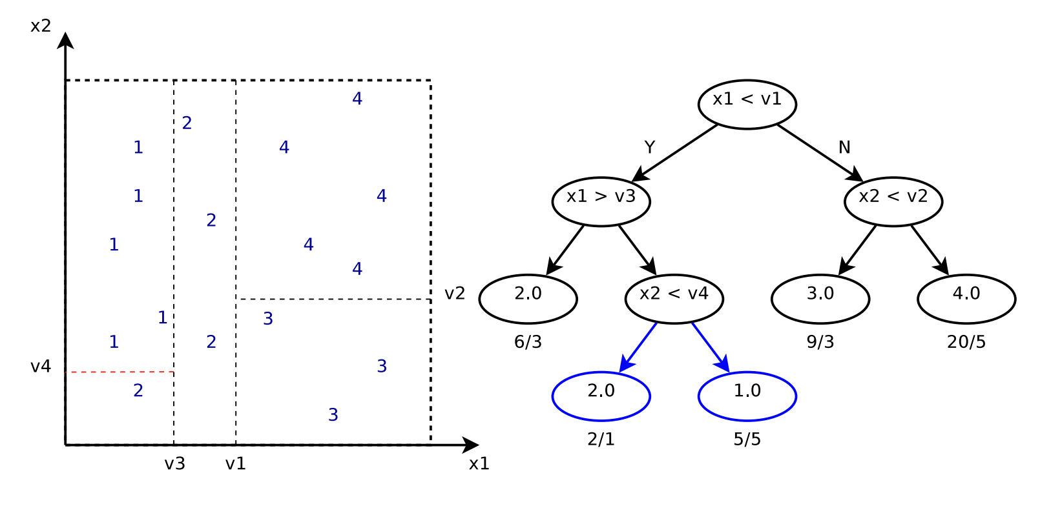
You can grow tree till 0 error (if no identical points with different scores)
3d e.g.: http://arogozhnikov.github.io/2016/06/24/gradient_boosting_explained.html

Slide 23
The concept of boosting
Motivating question:
Can we use individually weak machine learning classifiers to build a high-accuracy classification system?
Classic approach (AdaBoost)
Learn a small decision tree (often a 1-split decision stump)
It will get the biggest split in the data right
Repeat:
Upweight examples it gets wrong;
Downweight examples it gets right
Learn another small decision tree on that reweighted data
Classify with weighted vote of all trees
Weight trees by individual accuracy
Notes:
Good to hear!

Slide 24
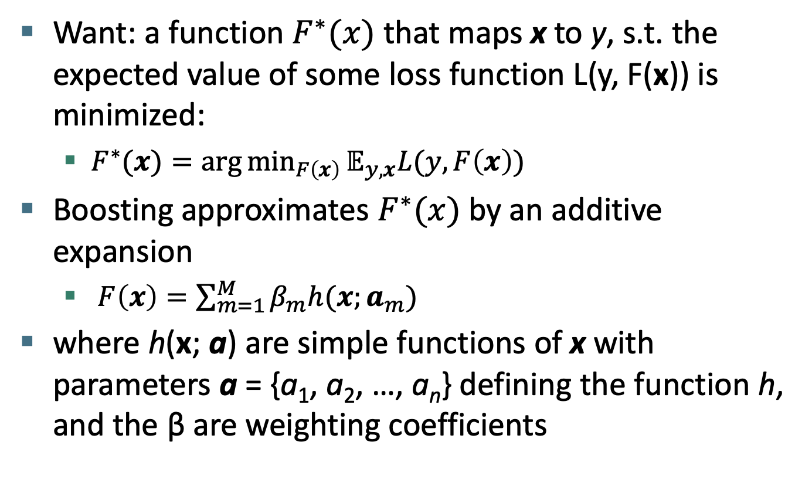
Towards gradient boosting: Function estimation
Want: a function $F^{∗}(x)$ that maps x to y, s.t. the expected value of some loss function L(y, F(x)) is minimized:
$F^{∗}(x)={\text{arg}{\text{min}}}_{F\left(x\right)}𝔼_{y,x}L(y, F\left(x\right))$
Boosting approximates $F^{∗}(x)$ by an additive expansion
$F\left(x\right)=\sum_{m=1}^{M}{β_{m}h(x;a_{m})}$
where h(x; a) are simple functions of x with parameters a = {a₁, a₂, …, a_{n}} defining the function h, and the β are weighting coefficients

Slide 25
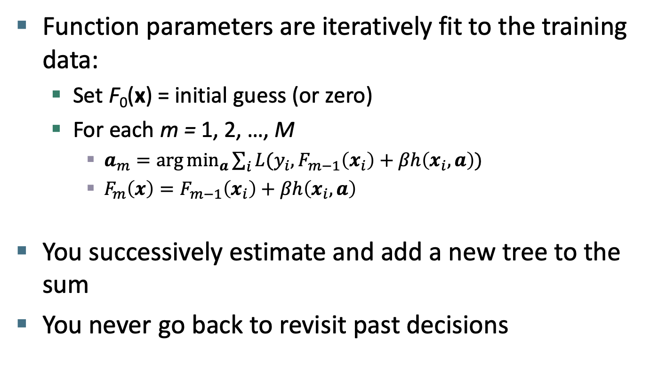
Finding parameters
Function parameters are iteratively fit to the training data:
Set F₀(x) = initial guess (or zero)
For each m = 1, 2, …, M
$a_{m}=\arg{{\text{min}}_{a}\sum_{i}{L(y_{i},F_{m−1}\left(x_{i}\right)+βh\left(x_{i}, a\right))}}$
${F_{m}\left(x\right)=F}_{m−1}\left(x_{i}\right)+βh\left(x_{i}, a\right)$
You successively estimate and add a new tree to the sum
You never go back to revisit past decisions

Slide 26
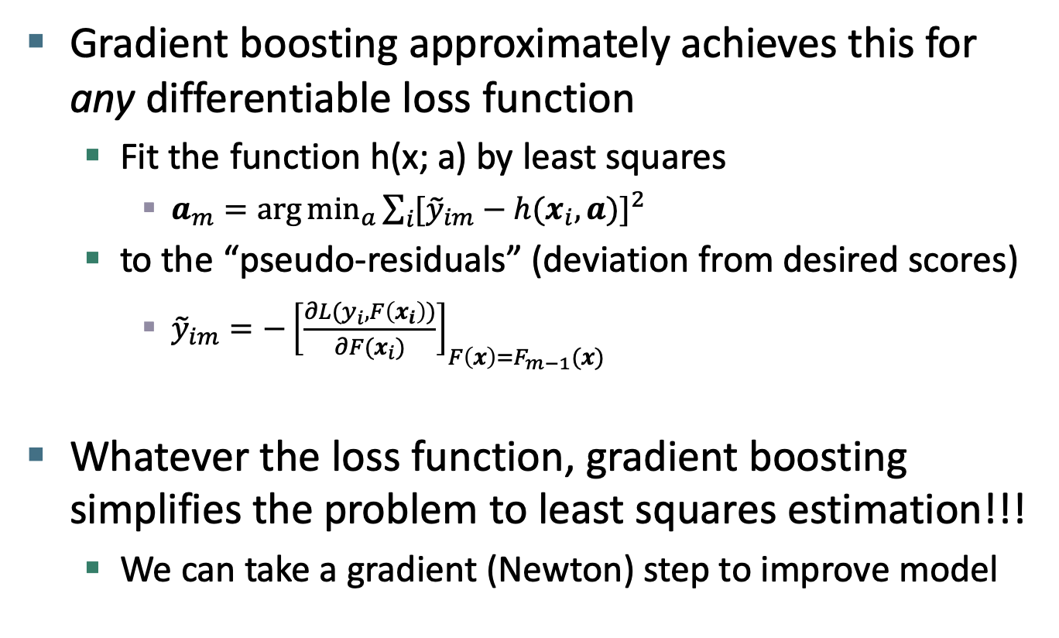
Finding parameters
Gradient boosting approximately achieves this for any differentiable loss function
Fit the function h(x; a) by least squares
$a_{m}=\arg{{\text{min}}_{a}}\sum_{i}{{[{\tilde{y}}_{im}−h(x_{i}, a)]}^{2}}$
to the “pseudo-residuals” (deviation from desired scores)
${\tilde{y}}_{im}=−{\left[\frac{∂L(y_{i},F\left(x_{i}\right))}{∂F(x_{i})}\right]}_{F\left(x\right)=F_{m−1}(x)}$
Whatever the loss function, gradient boosting simplifies the problem to least squares estimation!!!
We can take a gradient (Newton) step to improve model

Slide 27
Gradient tree boosting
Gradient tree boosting applies this approach on functions h(x; a) which are small regression trees
The trees used normally have 1–8 splits only
Sometimes stumps do best!
The allowed depth of the tree controls the feature interaction order of model (do you allow feature pair conjunctions, feature triple conjunctions, etc.?)

Slide 28
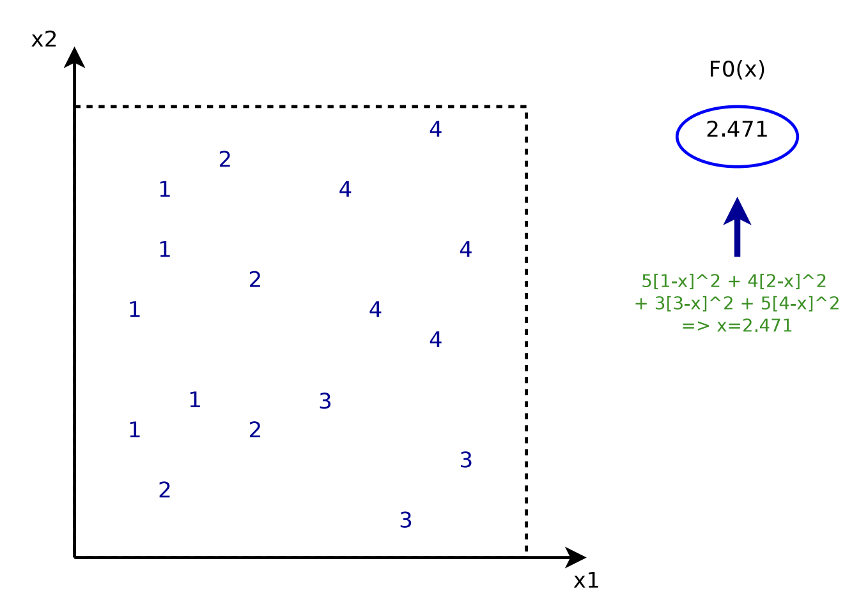
Learning a gradient-boosted regression tree
First, learn the simplest predictor that predicts a constant value that minimizes the error on the training data

Slide 29
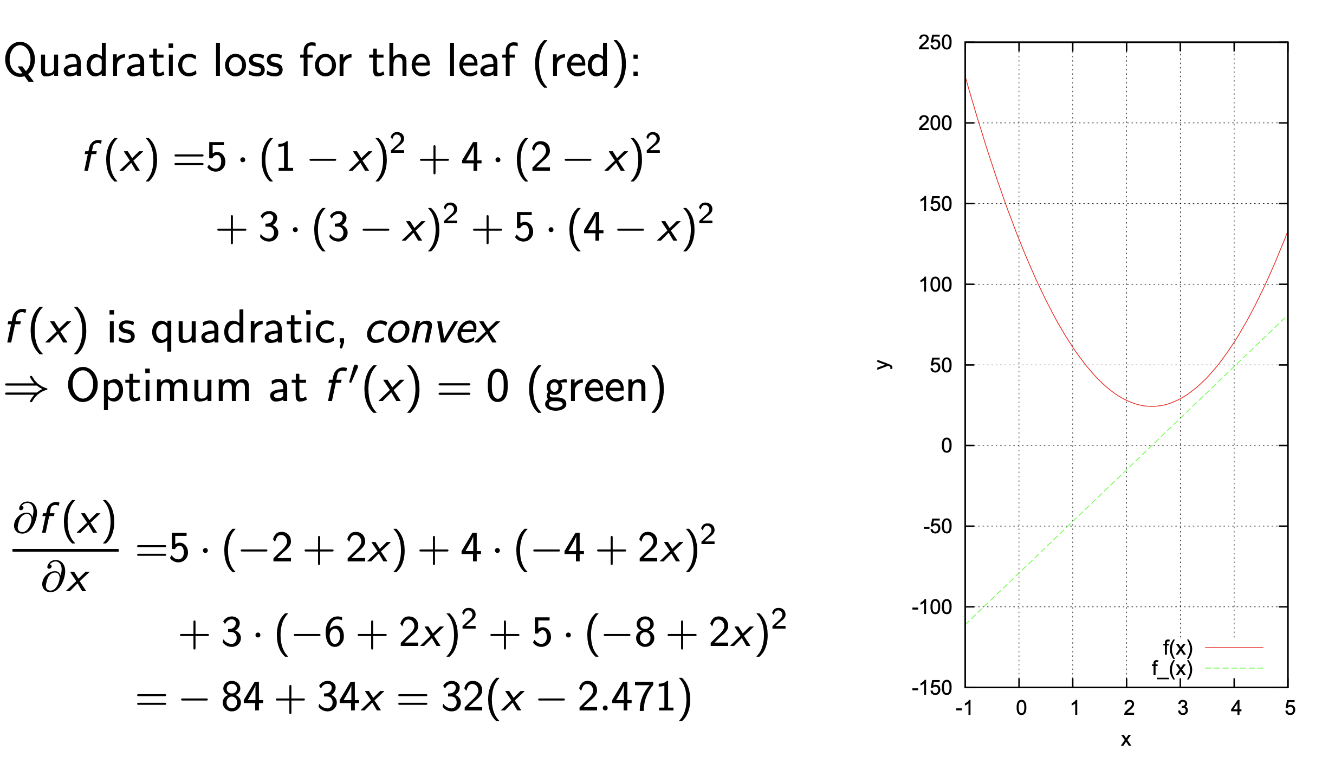

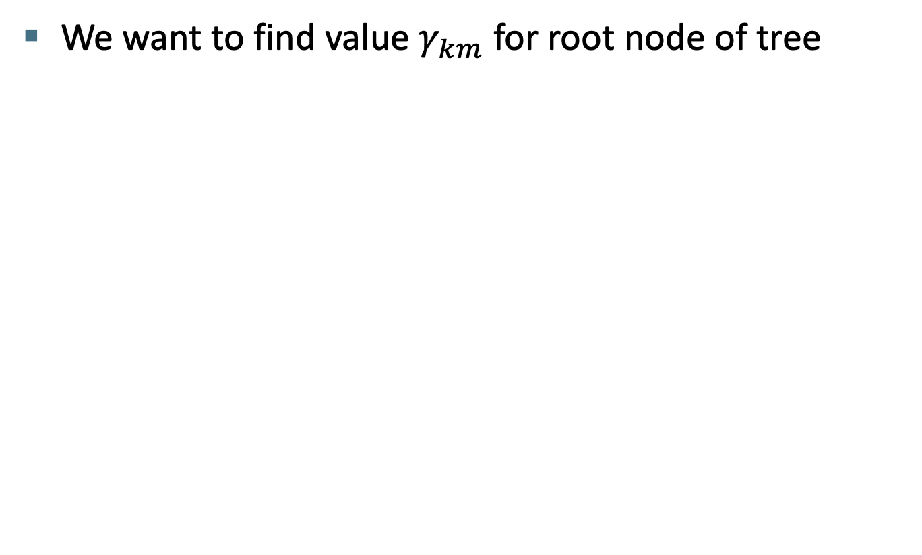
Learning a gradient-boosted regression tree
We want to find value $γ_{km}$ for root node of tree

Slide 30
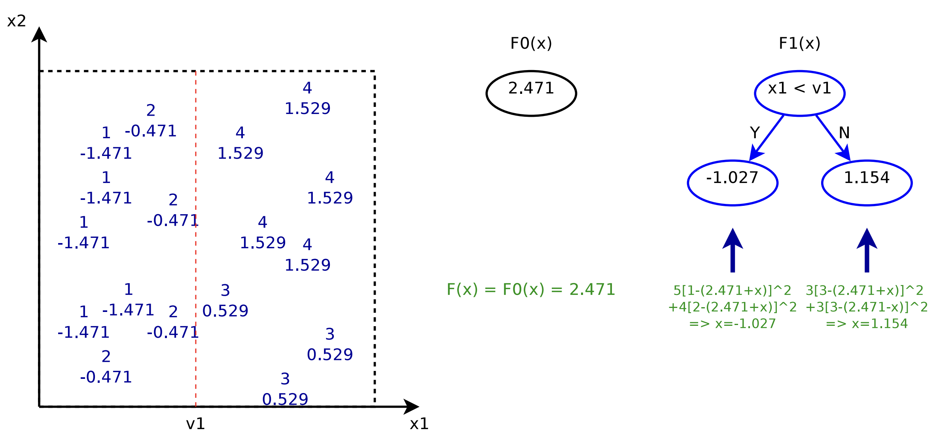
Learning a gradient-boosted regression tree
We split root node based on least squares criterion and build a tree predicting “pseudo-residuals”

Slide 31
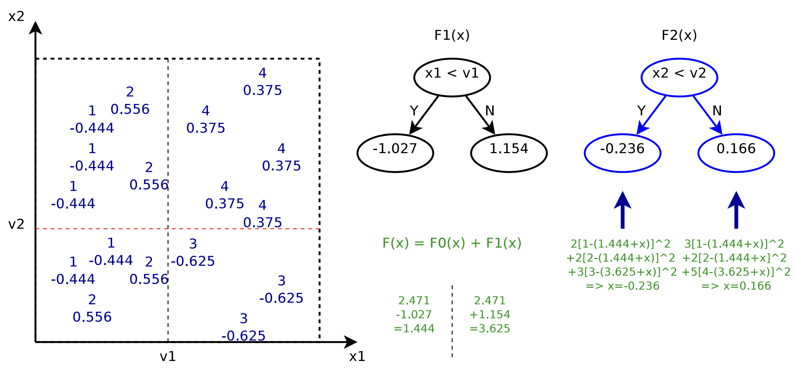
Learning a gradient-boosted regression tree
Then another tree is added to fit the actual “pseudo-residuals” of the first tree

Slide 32
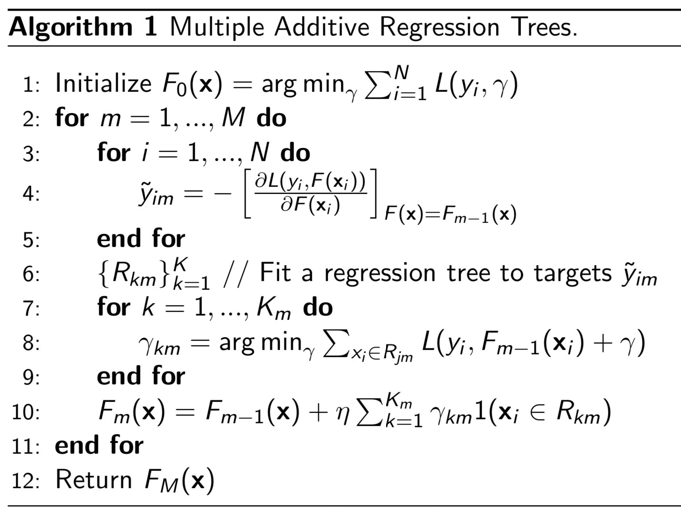
Multiple Additive Regression Trees (MART) [Friedman 1999]

Slide 33
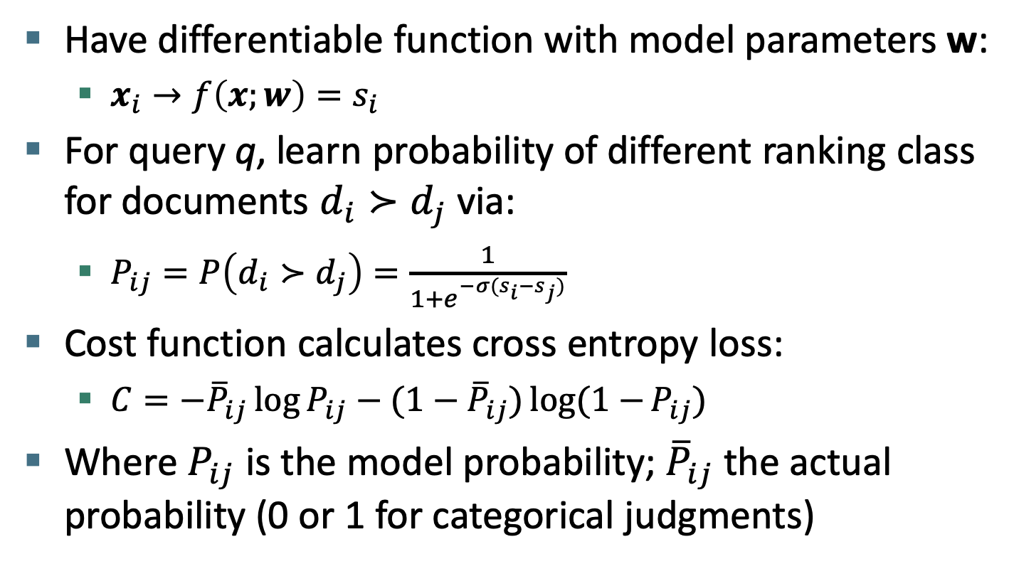
Historical path to LambdaMART: via RankNet (a neural net ranker)
Have differentiable function with model parameters w:
$x_{i}→f\left(x;w\right)=s_{i}$
For query q, learn probability of different ranking class for documents $d_{i}≻d_{j}$ via:
$P_{ij}=P\left(d_{i}≻d_{j}\right)=\frac{1}{1+e^{−σ(s_{i}−s_{j})}}$
Cost function calculates cross entropy loss:
$C=−{\overline{P}}_{ij}\log{P_{ij}}−{(1−\overline{P}}_{ij})log(1−{P_{ij})}$
Where $P_{ij}$ is the model probability; ${\overline{P}}_{ij}$ the actual probability (0 or 1 for categorical judgments)
Notes:
Make 2 slides and include more of Burges below

Slide 34
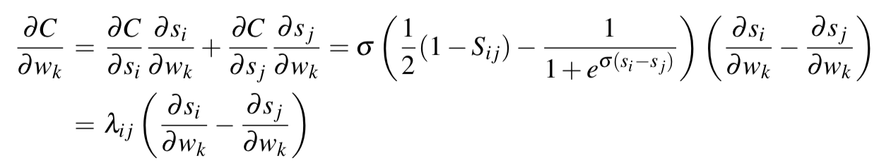
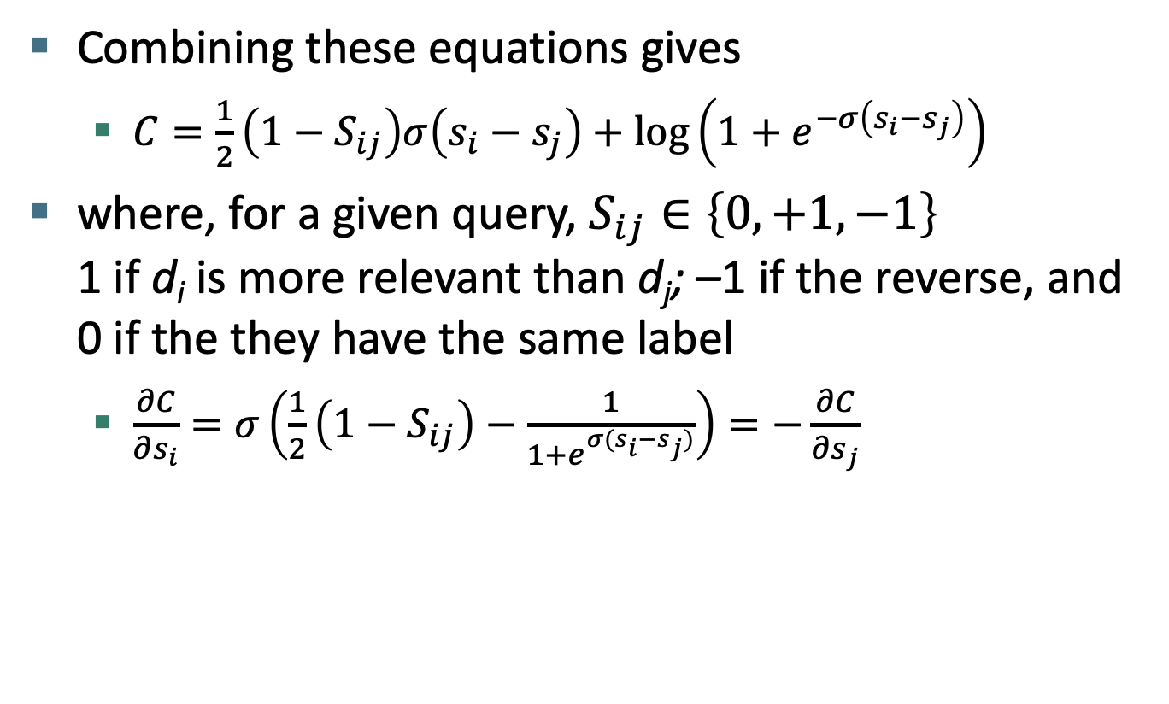
RankNet (Burges 2010)
Combining these equations gives
$C=\frac{1}{2}\left(1−S_{ij}\right)σ\left(s_{i}−s_{j}\right)+\log\left(1+e^{−σ\left(s_{i}−s_{j}\right)}\right)$
where, for a given query, $S_{ij}∈\left\{0,+1,−1\right\}$ 1 if d_{i} is more relevant than d_{j}; –1 if the reverse, and 0 if the they have the same label
$\frac{∂C}{∂s_{i}}=σ\left(\frac{1}{2}\left(1−S_{ij}\right)−\frac{1}{1+e^{σ(s_{i}−s_{j})}}\right)=−\frac{∂C}{∂s_{j}}$

Slide 35
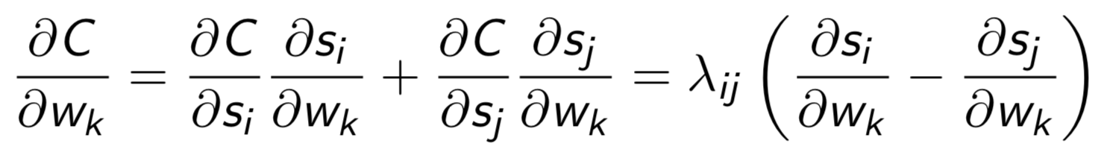
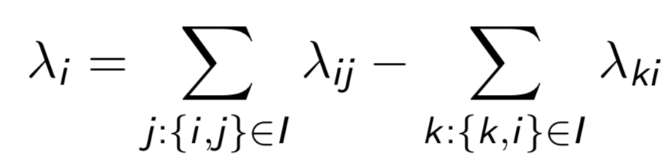
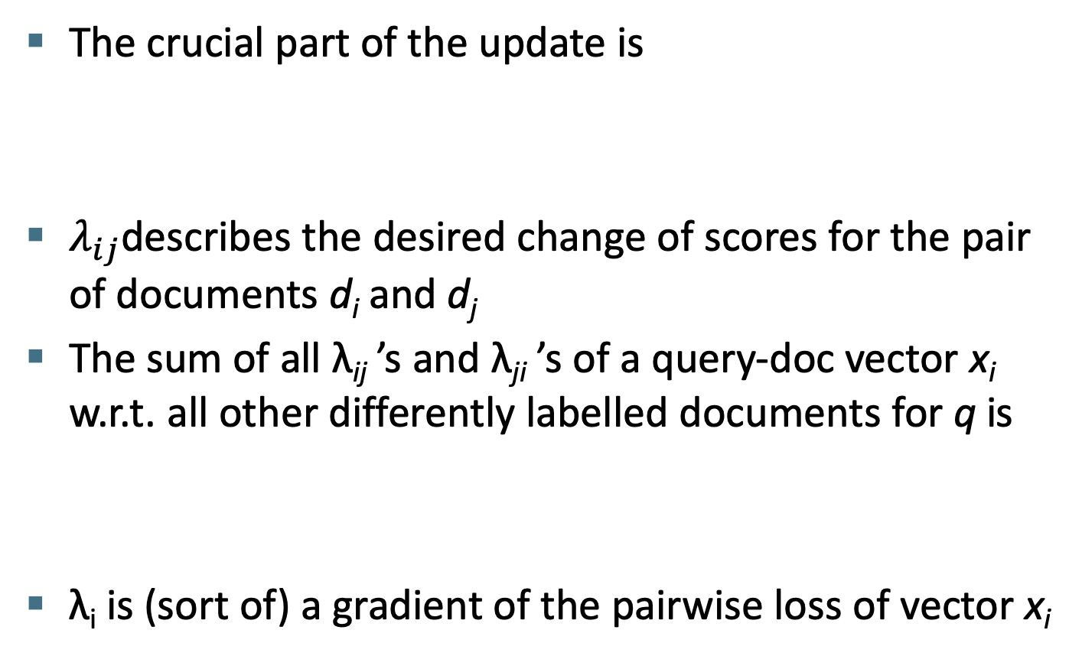
RankNet lambdas
The crucial part of the update is
$λ_{ij}$describes the desired change of scores for the pair of documents d_{i} and d_{j}
The sum of all λ_{ij} ’s and λ_{ji} ’s of a query-doc vector x_{i} w.r.t. all other differently labelled documents for q is
λ_{i} is (sort of) a gradient of the pairwise loss of vector x_{i}

Slide 36
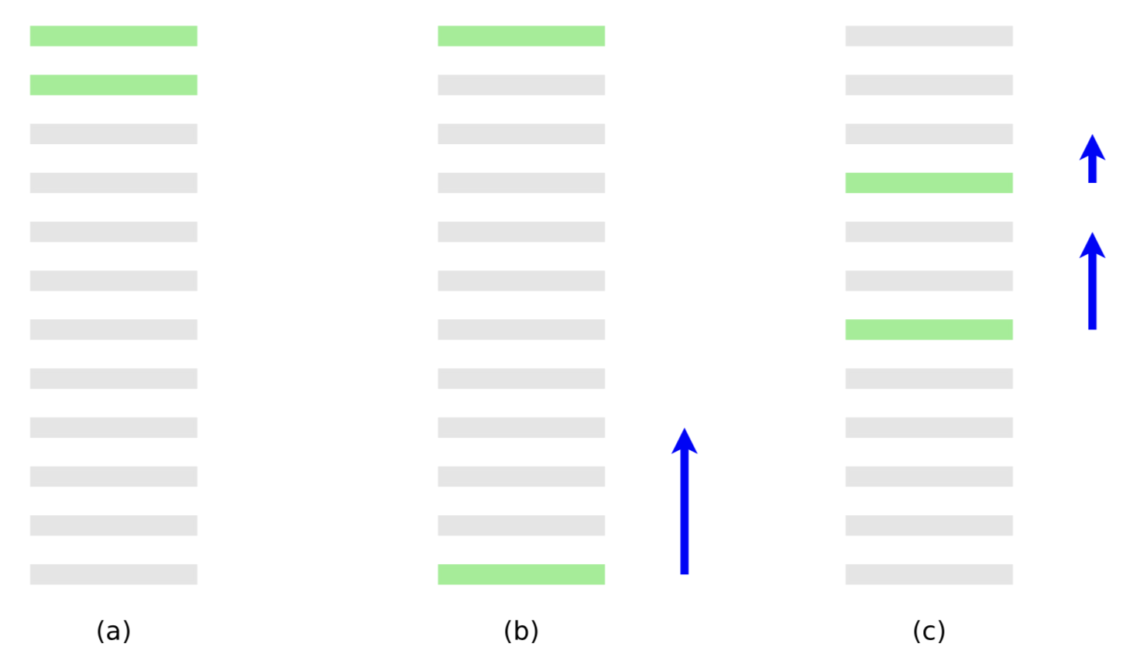
RankNet lambdas (Burges 2010)
(a) is the perfect ranking, (b) is a ranking with 10 pairwise errors, (c) is a ranking with 8 pairwise errors. Each blue arrow represents the λ_{i} for each query-document vector x_{i}

Slide 37
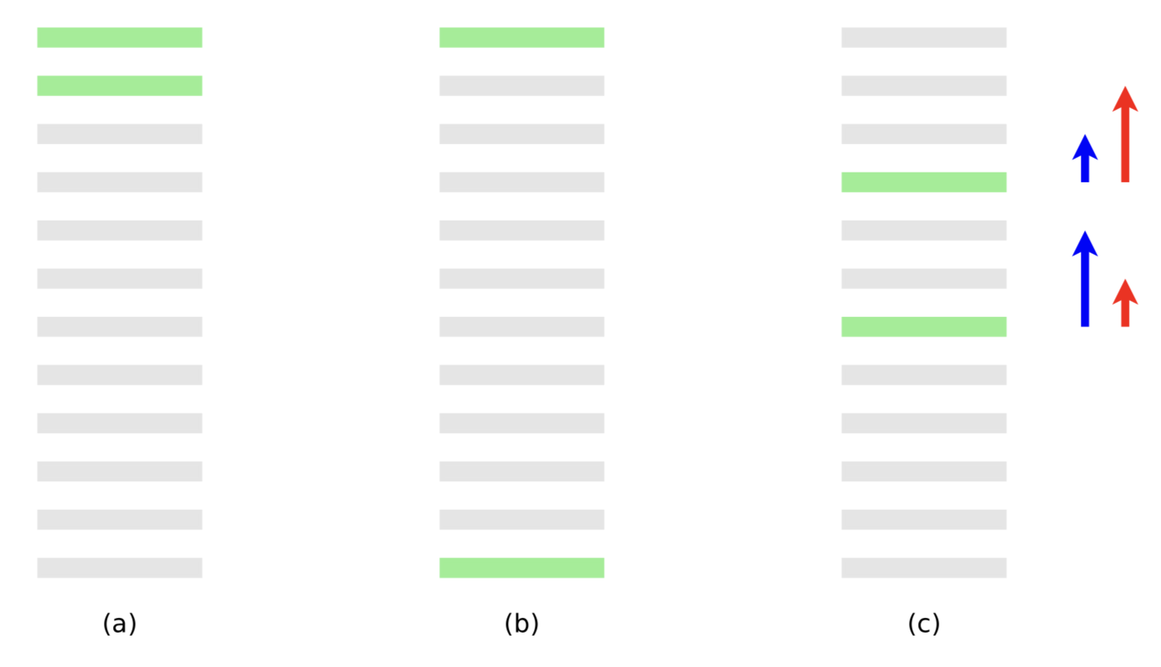
RankNet lambdas (Burges 2010)
Problem: RankNet is based on pairwise error, while modern IR measures emphasize higher ranking positions. Red arrows show better λ’s for modern IR, esp. web search.

Slide 38
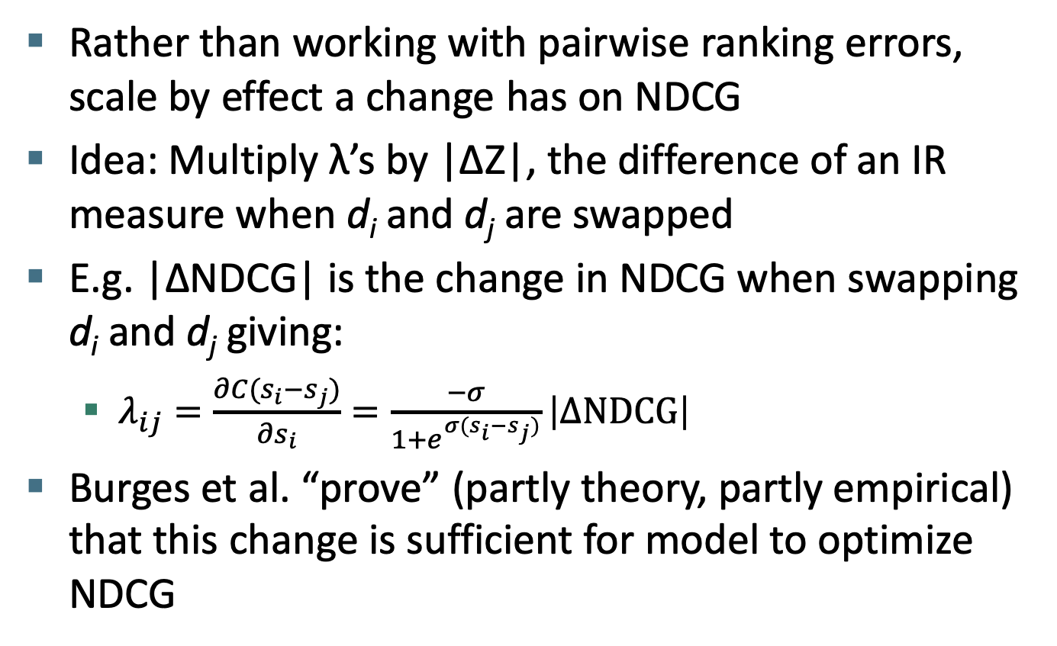
From RankNet to LambdaRank
Rather than working with pairwise ranking errors, scale by effect a change has on NDCG
Idea: Multiply λ’s by |∆Z|, the difference of an IR measure when d_{i} and d_{j} are swapped
E.g. |∆NDCG| is the change in NDCG when swapping d_{i} and d_{j} giving:
$λ_{ij}=\frac{∂C(s_{i}−s_{j})}{∂s_{i}}=\frac{−σ}{1+e^{σ(s_{i}−s_{j})}}\left|∆\text{NDCG}\right|$
Burges et al. “prove” (partly theory, partly empirical) that this change is sufficient for model to optimize NDCG

Slide 39
From LambdaRank to LambdaMART
LambdaRank models gradients
MART can be trained with gradients (“gradient boosting”)
Combine both to get LambdaMART
MART with specified gradients and optimization step

Slide 40
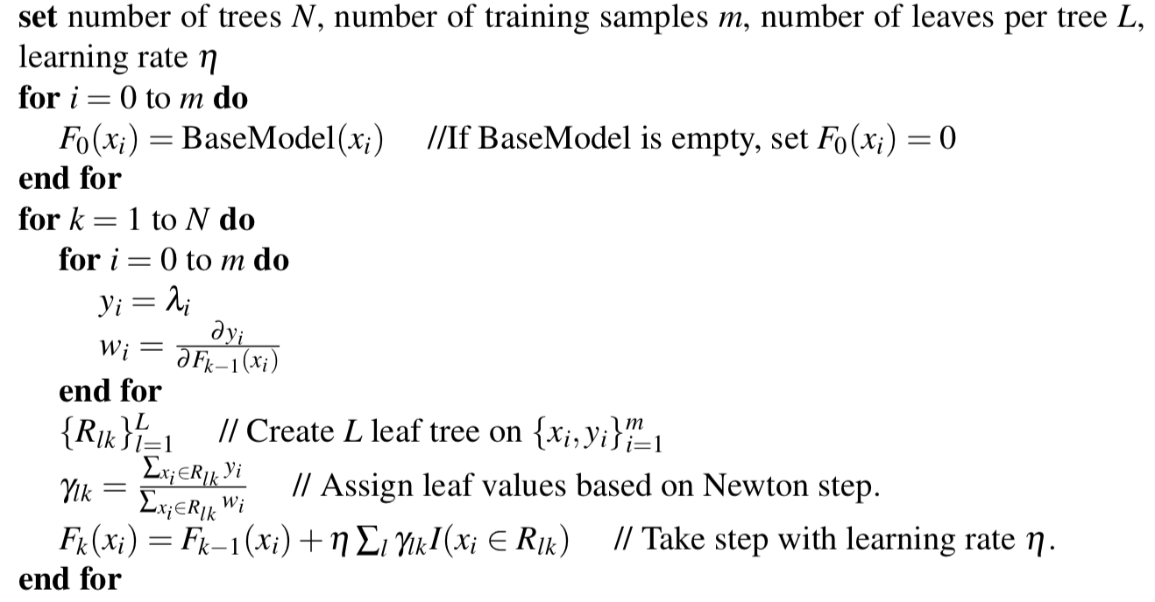
LambdaMART algorithm
R_{lk} is data items at leaf node l
Notes:
You’re still growing the tree greedily, and then using the gradient to set the leaf values.
This can fail because tree learning is greedy, but it usually works great!
Normally learning rate is kept small: effective regularization

Slide 41
Yahoo! Learning to rank challenge
Goal was to validate learning to rank methods on a large, “real” web search problem
Previous work was mainly driven by LETOR datasets
Great as first public learning-to-rank data
Small: 10s of features, 100s of queries, 10k’s of docs
Only feature vectors released
Not URLs, queries, nor feature descriptions
Wanting to keep privacy and proprietary info safe
But included web graph features, click features, page freshness and page classification features as well as text match features

Slide 42
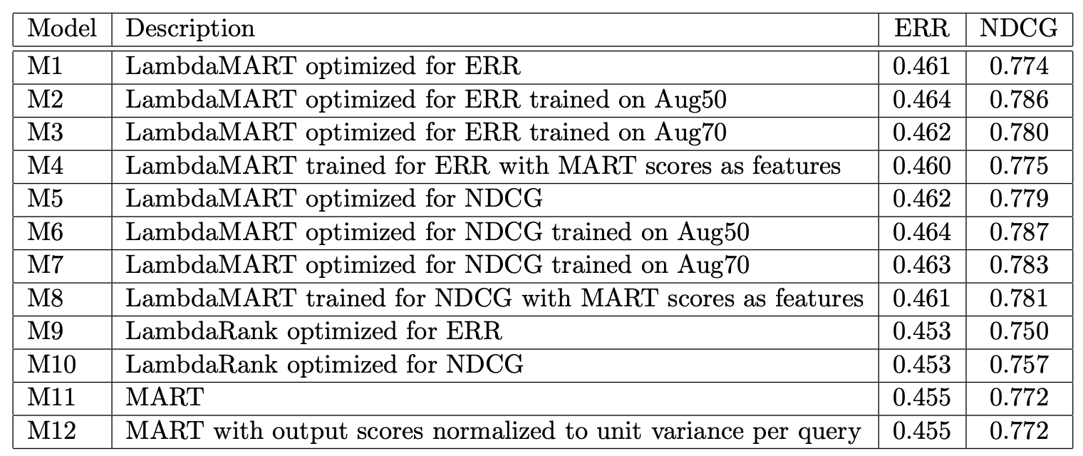
Burges et al. (2011) entry systems
ERR = Expected reciprocal rank; see Chapelle and Chang (2011)
Notes:
Aug50/70 are data augmentation methods adding repeated copies of sampled data.

Slide 43
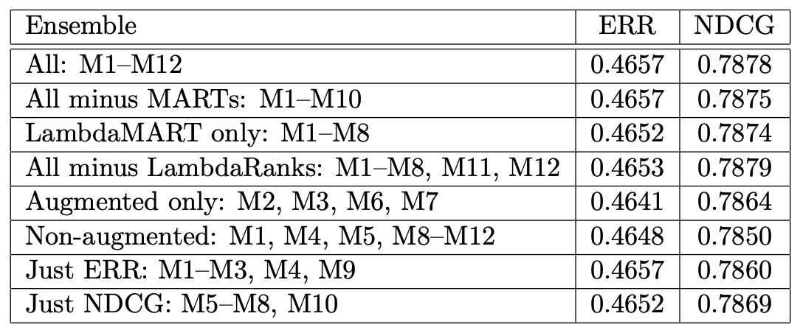
They didn’t need to combine so many

Slide 44
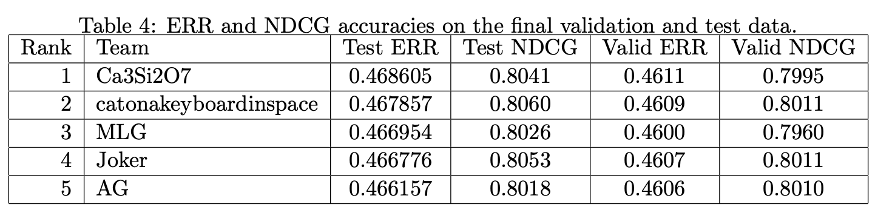
All good systems performed almost identically, trained on the same features
It’s not very clear that you need to use LambdaMART.
Methods like (pairwise) Logistic Rank seem to do just fine.
But use of trees seems to be de rigeur at search engine companies.
So maybe they’re a little better on big data?
Notes:
Same story as neural nets? Models that can increase in complexity as data grows?

Slide 45
Raw example of xgboost for ranking with LambdaMART
https://github.com/dmlc/xgboost/tree/master/demo/rank
git clone https://github.com/dmlc/xgboost.git
brew install unrar #somehow get unrar if don’t have it
cd gboost/demo/rank
./wgetdata.sh # gets one of the LETOR datasets
python notebook

Slide 46
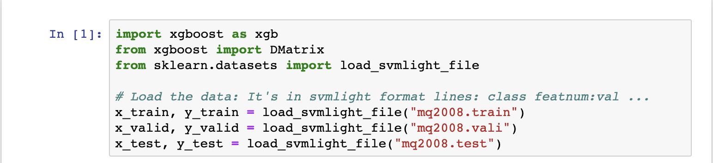
Raw example of xgboost for ranking with LambdaMART

Slide 47
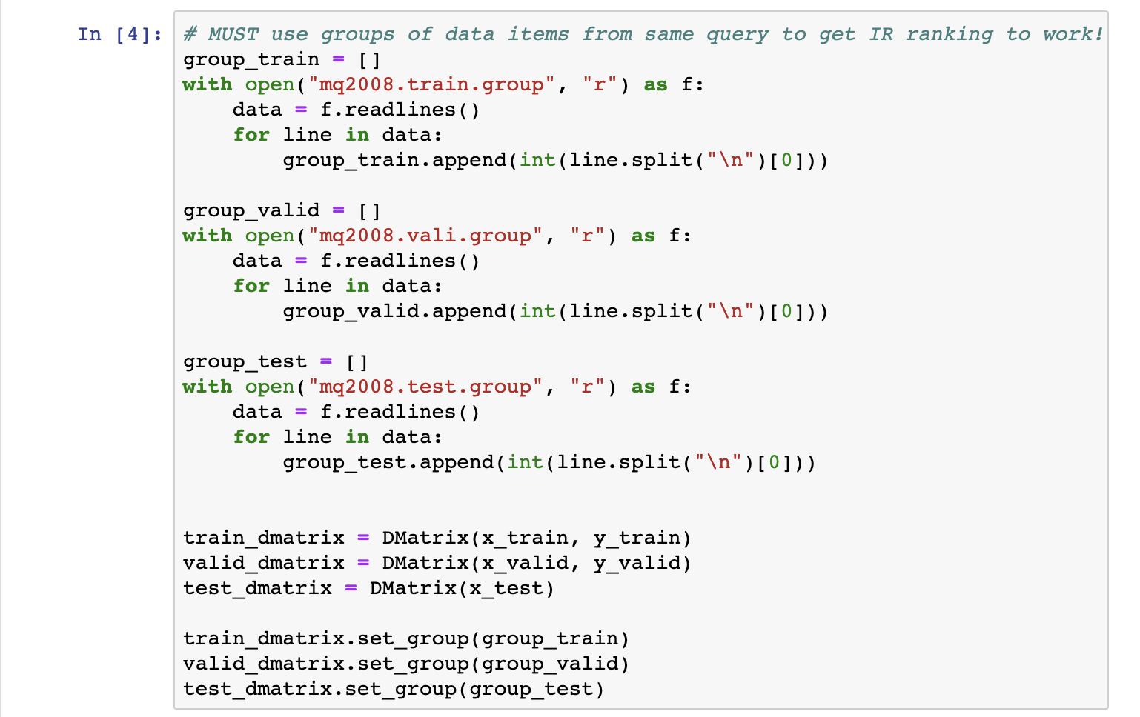
Raw example of xgboost for ranking with LambdaMART

Slide 48
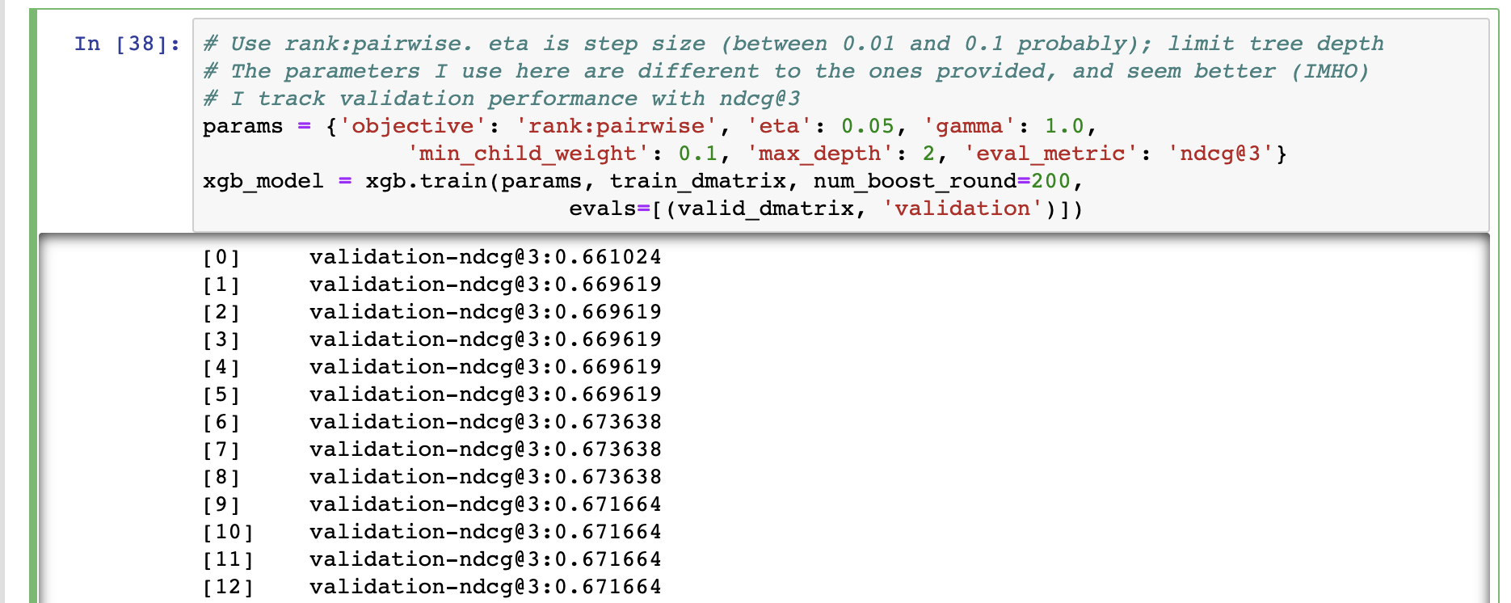
Raw example of xgboost for ranking with LambdaMART

Slide 49
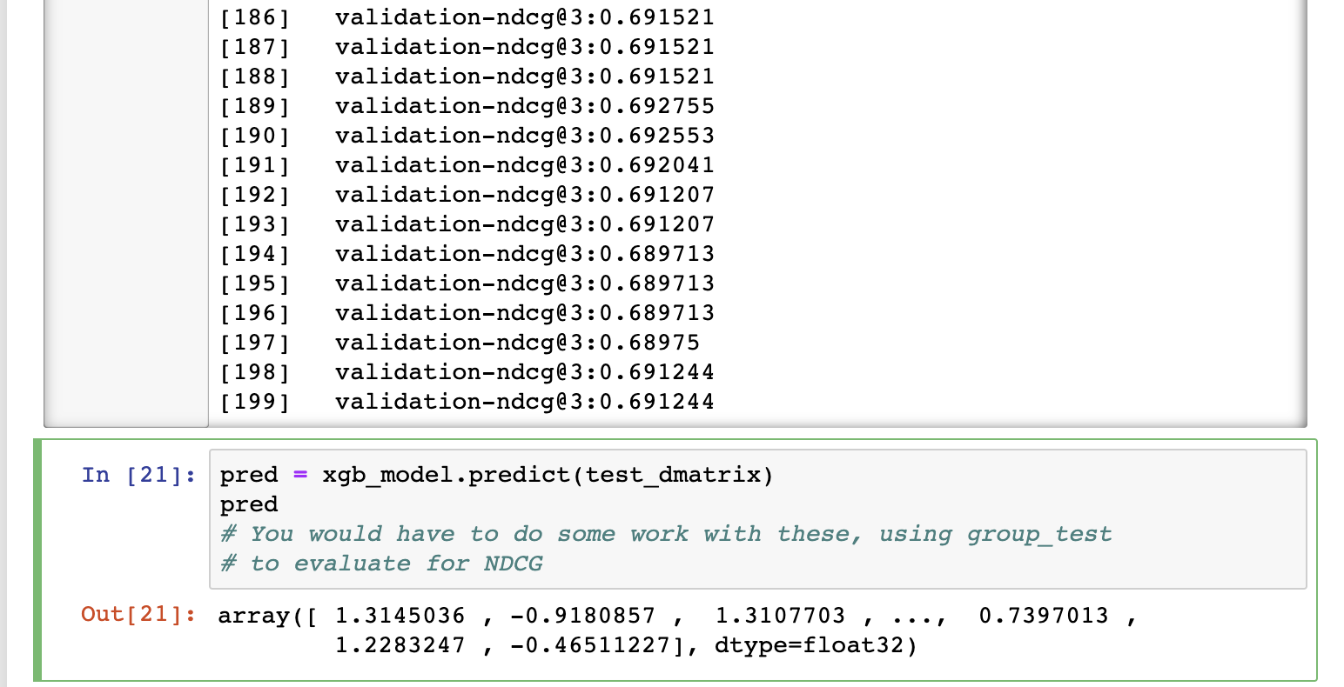
Raw example of xgboost for ranking with LambdaMART

Slide 50

http://www.quora.com/Why-is-machine-learning-used-heavily-for-Googles-ad-ranking-and-less-for-their-search-ranking
Notes:
Things have changed a lot now (to the extent I understand things), but traditionally ML was not used that much in Google search. This quora article has a detailed discussion of that. It particularly emphasizes wanting to have understandable ranking factors with known effects rather than just an aggregate increase in quality.

Slide 51
Summary
The idea of learning ranking functions has been around for about 20 years
But only more recently have ML knowledge, availability of training datasets, a rich space of features, and massive computation come together to make this a hot research area
It’s too early to give a definitive statement on what methods are best in this area
But machine-learned ranking over many features now easily beats traditional hand-designed ranking functions in comparative evaluations [in part by using the hand-designed functions as features!]
There is every reason to think that the importance of machine learning in IR will grow in the future.

Slide 52
Resources
IIR secs 6.1.2–3 and 15.4
Nallapati, R. Discriminative models for information retrieval. SIGIR 2004.
LETOR benchmark datasets
Website with data, links to papers, benchmarks, etc.
http://research.microsoft.com/users/LETOR/
Everything you need to start research in this area! But smallish.
C. J. C. Burges. From RankNet to LambdaRank to LambdaMART: An Overview. Microsoft TR 2010.
O. Chapelle and Y. Chang. Yahoo! Learning to Rank Challenge Overview. JMLR Proceedings 2011.

